Slide 1

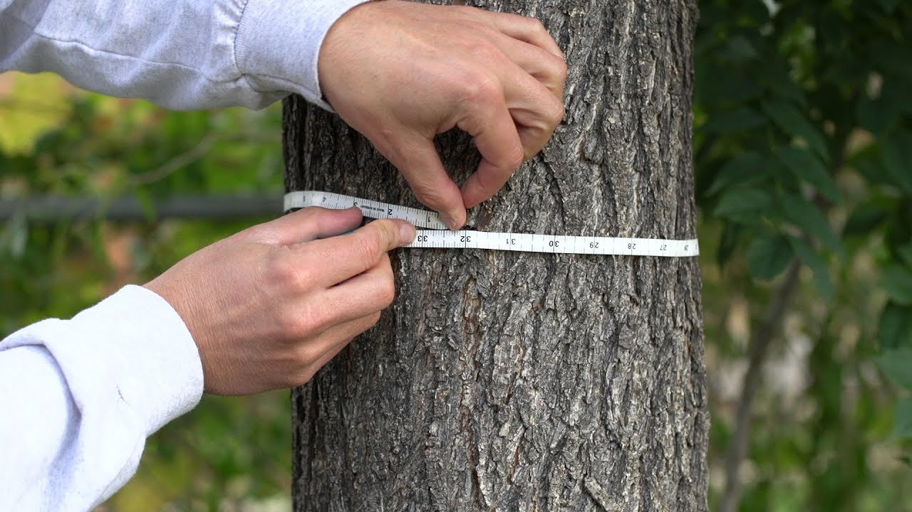
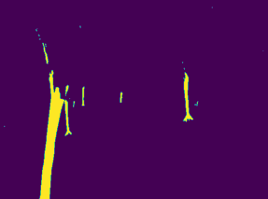
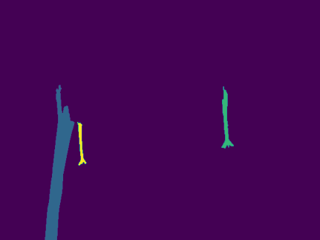


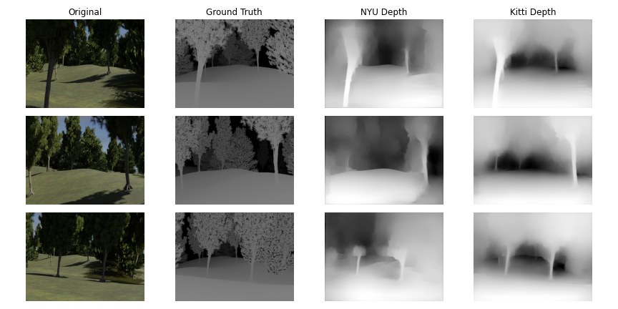
Estimating Biomass of Forests From Images Using Machine Learning
Research and Poster By: Samuel Wolnerman
Mentors: Professor Michael Grossberg, Nicholas Steiner
INTRODUCTION
One of the most important attributes measured on trees in forestry is the diameter of their stems at breast height. Among other things, tree stem diameter often correlated closely with other aspects of trees which are harder to measure, such as biomass. Generally, for researchers to estimate the total biomass of a forest, tedious measurements of many individual trees with diameter tape is required. These measurements are arduous and expensive as they require much time, labor, and equipment. To simplify the process of taking these important measurements, we wanted to see the effects of machine learning as an approach to this problem. More specifically, we explored the question if machine learning can accurately solve for the stem diameter when given individual images of trees.
RESULTS
The pre-trained neural network KITTI outperformed the NYU Depth model in almost every capacity. These depth maps were used to extract the tree trunks and give context for distance used to scale the measurements taken.
Figure 1: Standard technique for getting trunk circumference with a measuring tape.
BACKGROUND
Using the allometry of trees, we can approximate the biomass of a tree by its trunk diameter with the equation shown below. Due to climate change, there has been considerable interest in determining how much of a forest is carbon. From biomass, we can also accurately approximate carbon content contained in the tree, which is about 50% of its biomass.
As measuring an entire forest by hand is incredibly difficult, sampling of specie population is done which leads to larger errors in measurements. To eliminate the need for these measurement assumptions, as well as expediating the completion of these forest surveys, we set out to automate the measurements portion of the process.
Figure 3A: Sample image separated into tree trunks
Figure 3B: Main trunks separated into colors
Figure 3C: Separated to deal with one tree
Figure 3D: Trunk cut with line of best fit. Center of mass shown in red, with orthogonal line measuring trunk radius.
METHODS
After using image processing to extract the tree trunks, each trunk was isolated. We then used the orthogonal line to the line of best fit to measure the trunk’s radius in pixels.
In order to have images of trees with known depth maps and stem diameters, a virtual forest was constructed in Blender. A walkthrough video through this forest was generated and extracted into a string of JPEG images along with its depth map equivalent.
Using Python image processing libraries such as skimage, NumPy, and SciPy, the data was reduced to solely the trunks of the trees, allowing for later measurements. Pre-trained neural networks (such as KITTI² and NYU Depth³) were used to recover depth maps from the images.
CONCLUSIONS
Using the trunk’s radius in pixels we can find its pixel circumference at breast height. This measurement must be scaled with the depth map of each image to find the real-world measurement of the trunk’s circumference. While the depth maps we created via the pre-trained neural networks worked aptly, more research needs to be done on measuring the error produced by those depth maps for calculating the trunk measurements.
In the future, we will work on training a neural network on our own set of images, decreasing the error produced by our measurements. Once accurate measurements of the trunks are calculated, biomass will be estimated using allometry equations from Springer¹.
ACKNOWLEDGEMENTS
I would like to thank City College and the ORCA program for this amazing opportunity!
REFERENCES
West, P. W. (2015). Tree and forest measurement. Springer.
Silberman, N., Kohli, P., Hoiem, D., & Fergus, R. (n.d.). NYU depth Dataset V2. NYU Depth V2 " Nathan Silberman. Retrieved September 18, 2021, from https://cs.nyu.edu/~silberman/datasets/nyu_depth_v2.html.
Geiger, A., Lenz, P., & Urtasun, R. (n.d.). The KITTI Vision Benchmark Suite. Retrieved September 18, 2021, from http://www.cvlibs.net/datasets/kitti/.
Figure 2: First column contains images of the walk through the virtual forest. The second column shows the depth map of those respective images from Blender. Third and fourth columns contain the depth maps from the two pre-trained neural networks^{2,3}.

